Slide 1
LAWS2400 / LAWS8040 – Torts
Week 5 – Lecture 2
Negligence: Unpacking Duty of Care

Slide 2
Outline – Topic 5 Week 2
  Meaning of ‘reasonable foreseeability’
  Established categories of duty
  Novel cases and the salient features approach

Slide 3
Meaning of reasonable foreseeability
Recap:
Starting position for whether a DOC owed is the ‘neighbour principle’ from Donoghue v Stevenson - if you can reasonably foresee that your careless actions could put your neighbour at risk of harm then a DOC owed
But please note the law has evolved significantly since then and the neighbour principle is not the end of the inquiry… so this should be seen as a starting position only
Next issue: what exactly does reasonable foreseeability mean?

Slide 4
Meaning of reasonable foreseeability Contd.
What does reasonable foreseeability mean when working out whether a DOC is owed?
Consider Chapman v Hearse (1961) 106 CLR 112 (Chapman’s negligent driving resulted in a collision; Chapman was thrown out of the car and became unconscious; Dr Cherry, who was aiding Chapman, was struck by Hearse, resulting in his death)
Cherry’s widow successfully sued Hearse
Why was Chapman involved in this case then?

Slide 5
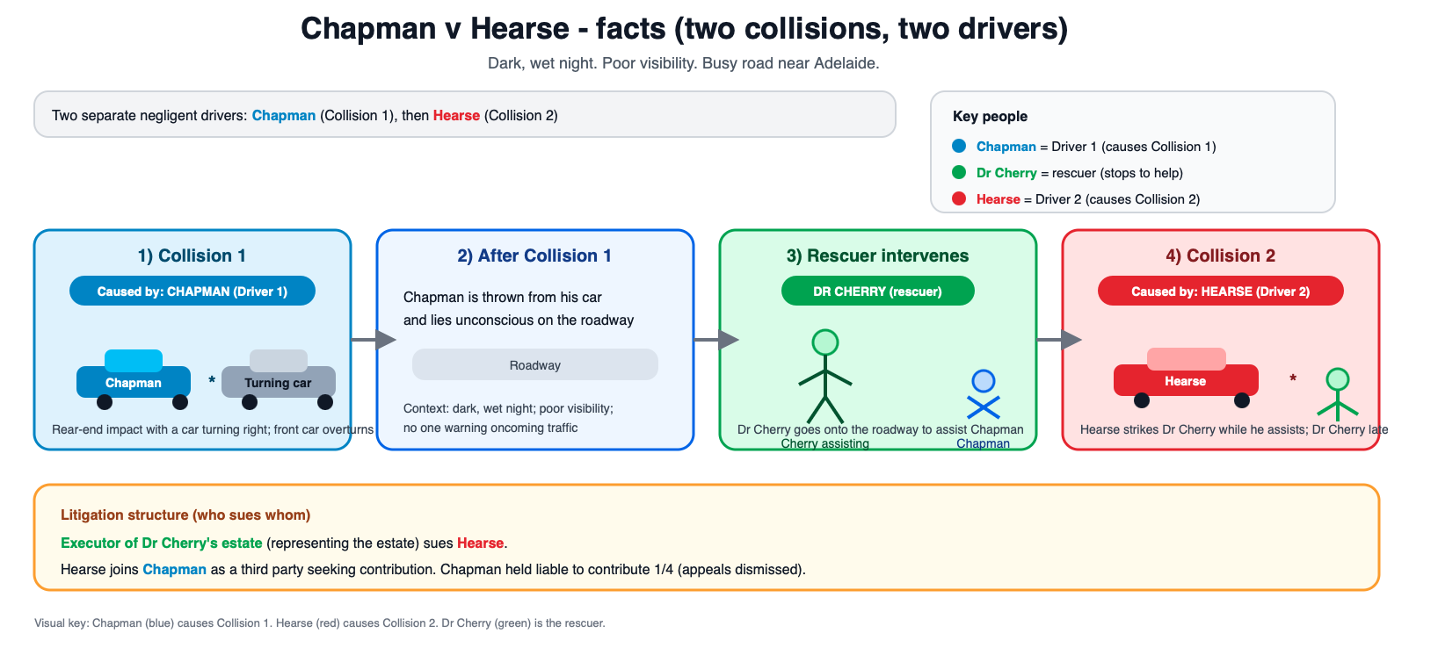
CORE QUESTION:
Did Chapman owe Dr Cherry a DOC? The court had to consider: was it reasonably foreseeable for Chapman that his conduct could cause harm to Dr Cherry?

Slide 6
Meaning of reasonable foreseeability Contd.
The High Court had to consider whether Chapman owed a duty of care to Dr Cherry. Could Chapman reasonably foresee that his conduct could cause harm to Dr Cherry?
But what does that mean... Chapman argued that he could not have foreseen that such a drastic chain of events would have happened (therefore no DOC). But is this the correct way to understand ‘reasonable foreseeability’?
How you understand the ‘reasonable foreseeability’ inquiry could change the outcome of cases.
The Court ruled that DOC existed. Chapman’s argument failed. The Court reasoned:
    “It is, we think, sufficient … to ask whether a consequence of the same general character as that which followed was reasonably foreseeable … it not necessary for the plaintiff to show that the precise manner in which his injuries were sustained was reasonably foreseeable; it is sufficient if it appears that injury to a class of person of which he was one might reasonably have been foreseen as a consequence”

Slide 7
Meaning of reasonable foreseeability Contd.
It should also be noted that what is reasonably foreseeable can change as per the state of scientific knowledge regarding risks to certain injuries – e.g., risk of exposure to asbestos; impact of climate change

Slide 8
Meaning of reasonable foreseeability
Reasonable foreseeability is a central concept to the tort of negligence
We will see the phrase ‘reasonable foreseeability’ come up three times when working through different elements of negligence – but each time we are assessing different things:
    duty of care: whether an injury was reasonably foreseeable to a “class of persons” – emphasis on the relationship between parties
    breach of duty: whether “the kind of carelessness” by D might cause damage to P – emphasis on D’s action
    whether damage was ‘remote’ or causally linked to D: whether the “kind of damage” suffered by the plaintiff was reasonably foreseeable as a possible outcome – emphasis on the damage suffered by P

Slide 9
Meaning of reasonable foreseeability
This concept was explained by Glass JA in Minister Administering the Environmental Planning and Assessment Act 1979 v San Sebastian Pty Ltd [1983] 2 NSWLR 268 (at 395- 396):
“A recognition has emerged that the foreseeability inquiry at the duty, breach and remoteness stages raises different issues which progressively decline from the general to the particular.
The proximity upon which a Donoghue type duty rests depends upon proof that the defendant and plaintiff are so placed in relation to each other that it is reasonably foreseeable as a possibility that careless conduct of any kind on the part of the former may result in damage of some kind to the person or property of the latter: Chapman v Hearse (1961) 106 CLR 112 at 120, 121.
The breach question requires proof that it was reasonably foreseeable as a possibility that the kind of carelessness charged against the defendant might cause damage of some kind to the plaintiff's person or property: Overseas Tankship (UK) Ltd v Miller Steamship Co Pty Ltd (The Wagon Mound (No 2)) AC 617; Wyong Shire Council v Shirt(1980) 146 CLR 40.
The remoteness test is only passed if the plaintiff proves that the kind of damage suffered by him was foreseeable as a possible outcome of the kind of carelessness charged against the defendant: Mount Isa Mines v Pusey (1970) 125 CLR 383 at 390.”
Duty (general)
Breach (more specific)
Damage (particular)

Slide 10
Roadmap: How do we work out whether a DOC is owed?
  Starting position is the ‘neighbour principle’ from Donoghue v Stevenson - if you can reasonably foresee that your careless actions could put your neighbour at risk of harm then a DOC owed – but the law has evolved significantly since this basic principle…
  What does reasonable foreseeability mean? “not necessary for the plaintiff to show that the precise manner in which his injuries were sustained was reasonably foreseeable; it is sufficient if it appears that injury to a class of person of which he was one might reasonably have been foreseen as a consequence” Chapman v Hearse
  Once we have applied these broader principles, then we need to consider these points (each point is discussed in detail):
  Does the case fall into an ‘established relationship category?’
  If the case falls outside of an established category, then it is what we refer to as a ‘novel case’. If novel, we need more than reasonable foreseeability to establish a DOC. We need to apply the salient features approach.

Slide 11
Established relationships
In most cases, the issue of whether the defendant owed the plaintiff a duty of care is uncontroversial
This is because the relationship/situation between the P and D falls into an “established category”
Ie that relationship has come before the courts in previous cases and the courts have recognized that relationship as giving rise to a DOC
In such cases you can point to case law history to show the relationship falls into an established category – e.g. “this is a manufacturer/consumer case which is an established category per Donoghue v Stevenson”

Slide 12
Established relationships
The courts have recognized certain relationships as giving rise to a DOC, including:
  Driver of vehicle owes a duty to other road users
  Employers owe a duty to their employees
  A doctor owes a duty to their patients
  A manufacturer owes a duty to consumers/users of their products
  A solicitor owes a duty to exercise due care in their work for their clients
But note: sometimes the facts of a particular case can draw the case away from the accepted paradigm… eg Chapman v Hearse was a car accident case but because of its unusual facts, the parties raised the question of whether a DOC was owed

Slide 13
Novel cases
Approach in novel categories
When the factors move away from the original paradigm, more than reasonable foreseeability of the harm is required to establish a duty of care
In such novel cases, Australian courts adopt an incremental approach and consider the salient factors

Slide 14
Novel cases
Consider the decision in Sullivan v Moody (2001) 207 CLR 562 (the father was suspected of sexually abusing her daughter; the medical practitioner and the social workers were alleged to have acted negligently in examining the child and investigating the possibility of sexual abuse; no criminal charges were laid; caused divorce and other impacts on the family’s life; the father alleged that he suffered shock, distress, psychiatric injury and consequential financial loss)
The key question before the High Court was whether the defendants owed a duty to the father to exercise reasonable care in investigating the allegations of sexual abuse

Slide 15
Novel cases
The High Court did not find a duty of care in the given circumstances
It noted that if mere reasonable foreseeability of the harm entailed a legal liability, this would:
    impose an intolerable burden of potential lability on people
    result in the tort of negligence subverting many other principles of law and statutory provisions

Slide 16
Novel cases
The Court considered coherence of the law as an important factor – eg the defendants’ duty to protect the interests of children being paramount
It also considered difficulties in limiting the extent and potential indeterminacy of liability (duty may not be limited to father – but also friends, teachers or anyone else who is suspected of abusing child)
The court highlighted these issues as salient (or relevant) factors… similar salient factors were raised in our next case…

Slide 17
Novel cases
The Court of Appeal applied the salient factors approach in the Caltex Refineries Pty Ltd case (Stavar’s husband was exposed to asbestos while working at an oil refinery; when washing his contaminated work clothes, Stavar’s wife was exposed to asbestos dust and developed cancer)
Employee was the husband (employer owing an employee a duty of care is not novel), but this case had to consider whether the employer owed a duty to the employee’s wife? So novel case = salient factors, incremental approach
It held that a duty of care could be found in the facts of the case

Slide 18
Novel cases
What are the salient factors?
The court did provide a list of factors in Caltex Refineries – see the judgment or your text at [9.35]
But a note on how to read this list: the list is not exhaustive and the plaintiff is not required to meet all factors
Key factors include:
  Foreseeability: Whether harm to the plaintiff was reasonably foreseeable.
  Control: The degree and nature of control the defendant could exercise to avoid the risk.
  Vulnerability: The plaintiff’s inability to protect themselves from the harm.
  Reliance and Responsibility: Any assumption of responsibility or reliance by the plaintiff.
  Coherence: Consistency with the scope of relevant statutes, public policy, and broader legal principles.

Slide 19
Summary:
How do we work out whether a DOC is owed?
  Starting position is the ‘neighbour principle’ from Donoghue v Stevenson - if you can reasonably foresee that your careless actions could put your neighbour at risk of harm then a DOC owed – but the law has evolved significantly since this basic principle…
  What does reasonable foreseeability mean? “not necessary for the plaintiff to show that the precise manner in which his injuries were sustained was reasonably foreseeable; it is sufficient if it appears that injury to a class of person of which he was one might reasonably have been foreseen as a consequence” Chapman v Hearse
  Once these basic tests are passed, you need to figure out:
    Does the case fall into an ‘established relationship category?’
    If the case falls outside of an established category then it is ‘novel’. If novel, we need more than reasonable foreseeability to establish a DOC. We need to apply the salient features approach.
This isn’t the end of the duty element though….
There are several types of cases that have distinct rules around whether a DOC will be owed. e.g. cases of pure mental harm or when the defendant is a public authority…
Duty topic is to be continued next week!

